Slide 1
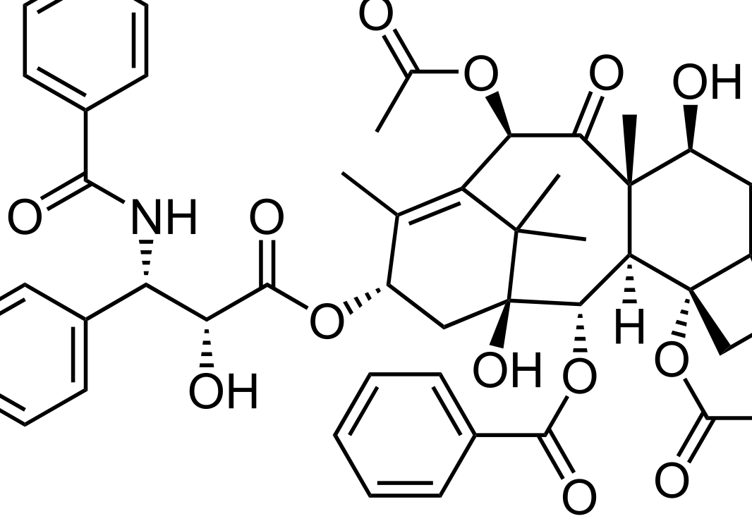

CS207 FINAL PROJECT
GROUP 1 – CHEMKIN AND OUTPUT PACKAGE
PREPARED FOR
DAVID SONDAK
CHARLES LIU
ERIC WU
KEVIN WU
BOYUAN SUN
PAUL BLANKLEY
RYAN JANSSEN
11 DECEMBER 2017
STRICTLY PRIVATE AND CONFIDENTIAL

Slide 2

CS207 FINAL PROJECT
GROUP 1 – CHEMKIN AND OUTPUT PACKAGE
PREPARED FOR
DAVID SONDAK
CHARLES LIU
ERIC WU
KEVIN WU
BOYUAN SUN
PAUL BLANKLEY
RYAN JANSSEN
11 DECEMBER 2017
STRICTLY PRIVATE AND CONFIDENTIAL

Slide 3

CHEMKIN207 is a package for calculating and outputting chemical reactions
Given reaction definitions, concentrations, and temperatures, calculate progress rates and reaction rates
Uses NASA polynomial method
Supports reversible and irreversible elementary reactions
Compatible with Python 3.0-3.6 (inclusive)
INTRODUCING CHEMKIN207

Slide 4
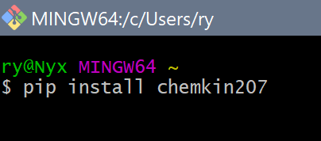
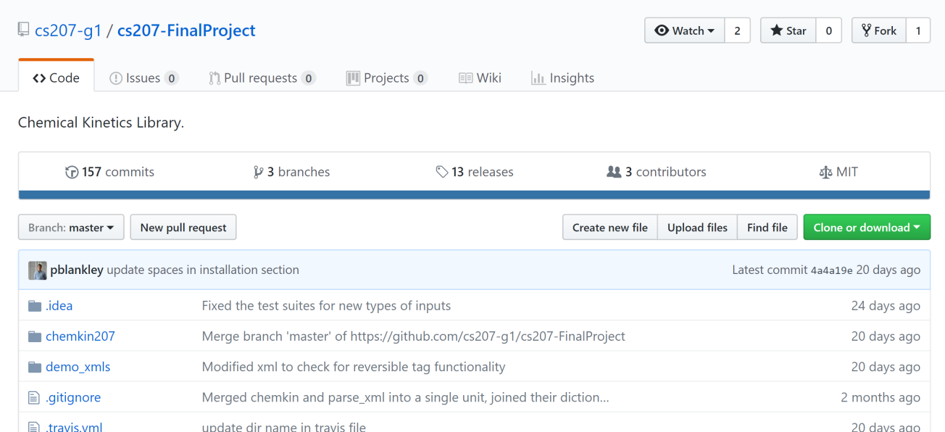
PACKAGE INSTALLATION
TWO INSTALLATION OPTIONS
OPTION 1: PIP
pip install chemkin207
OPTION 2: GITHUB
Clone:
https://github.com/cs207-g1 /cs207-FinalProject
Run:
setup.py

Slide 5
THREE CLASS FAMILIES
IrreversibleReaction()/ ReversibleReaction(): Calculate respective reaction rates
Reaction(): Stores information related to one reaction in a set of reactions
ReactionSet(): Represents entire reaction for a set of elementary reactions
MultiReactionSet(): Used to compare elements from several ReactionSets
IrreversibleReaction()
ReversibleReaction()
Reaction
ReactionSet()
Legend:
MultiReactionSet()
Class

Slide 6
DATA FLOW
IrreversibleReaction()
NASA coefs (txt)
reaction_coef_forward
_arrehennius
get_nasa_coefs
reaction_coef_backward
_mod_arrehennius
make_coef_sql
ReversibleReaction()
get_query
internal SQLite
reaction_coef
progress_rate
reaction_rate
Reaction()
set_params
get_params
reaction_coefs
progress_rates
get_reactions
ReactionSet()
reaction_rates
reactions
list (XML)
Legend:
table_output
find_rates
Class
MultiReactionSet()
class method
dataset
to_table_multi
to_table
plot_rates_against_temperature

Slide 7
INTENDED USAGE
USER INPUTS
IrreversibleReaction()
NASA coefs (txt)
reaction_coef_forward
_arrehennius
get_nasa_coefs
reaction_coef_backward
_mod_arrehennius
make_coef_sql
ReversibleReaction()
get_query
internal SQLite
reaction_coef
progress_rate
reaction_rate
Reaction()
set_params
get_params
reaction_coefs
progress_rates
get_reactions
ReactionSet()
reaction_rates
reactions
list (XML)
USER OUTPUTS
table_output
find_rates
MultiReactionSet()
to_table_multi
to_table
plot_rates_against_temperature

Slide 8
INTENDED USAGE
USER INPUTS
User can simply:
input NASA coefficients (once)
set reactions via XML
query reaction rates, progress rates, or plots/tables
IrreversibleReaction()
NASA coefs (txt)
reaction_coef_forward
_arrehennius
get_nasa_coefs
reaction_coef_backward
_mod_arrehennius
make_coef_sql
ReversibleReaction()
get_query
internal SQLite
reaction_coef
progress_rate
reaction_rate
Reaction()
set_params
get_params
reaction_coefs
progress_rates
get_reactions
ReactionSet()
reaction_rates
reactions
list (XML)
USER OUTPUTS
table_output
find_rates
MultiReactionSet()
to_table_multi
to_table
plot_rates_against_temperature

Slide 9
OUTPUT PACKAGE: MOTIVATION
ENABLING A WIDE RANGE OF OUTPUT USE CASES
Obtaining reaction rates is rarely the last step in the workflow:
Typical usage for reaction rate calculations: | CHEMKIN207 tool
Publication of findings via LATEX | .to_table(‘LATEX’)
Sharing/storing reactions | .to_table(‘HDF5’) .to_table(‘CSV’)
Copy/paste inline in email to colleagues | .to_table(‘TXT’)
Export to secondary analysis in excel etc. | .to_table(‘CSV’)
Visualization/analysis via plots, determine max/min rates | .plot_rates_against_temperature() .find_rates()
Compare/contrast species in different reactions | .to_table_multi(‘*’)
CHEMKIN207 enables these in a repeatable, consistent format!

Slide 10
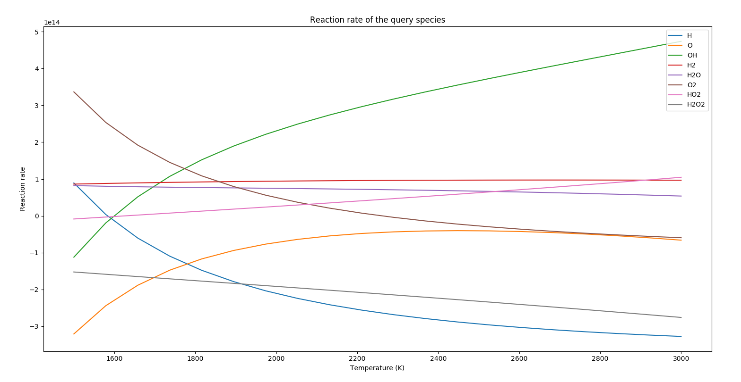
PLOT_RATES_AGAINST_TEMP() METHOD
TWO INSTALLATION OPTIONS
ReactionSet.plot_rates_against_temperature(query_species, concs, temps)
Supporting function can be used to output max/min reaction rate/temperature for each specie:
ReactionSet.find_rates(query_species, concs, temps)

Slide 11
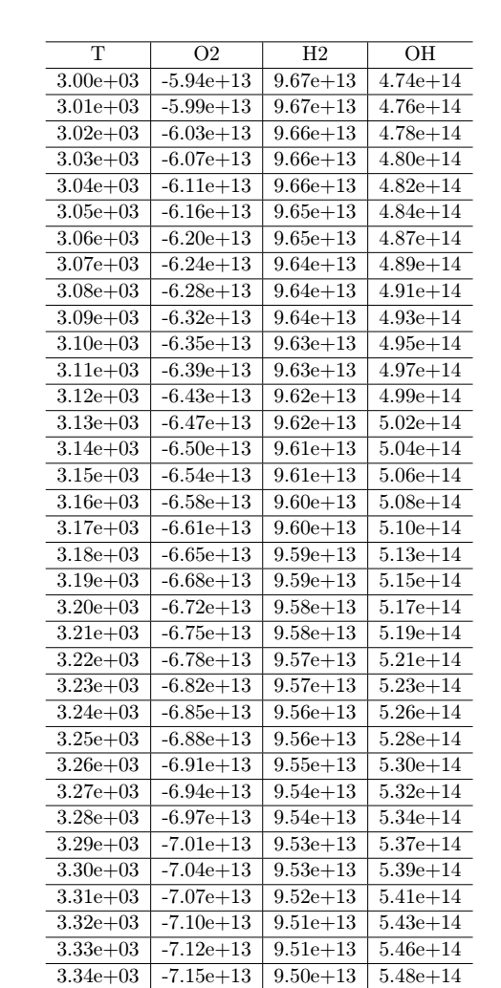
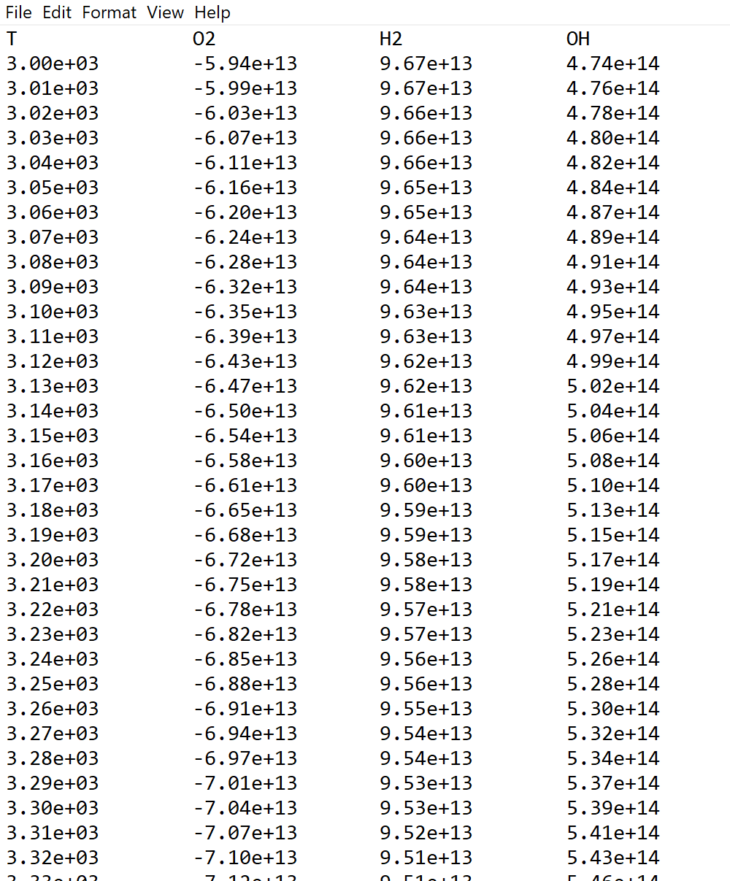
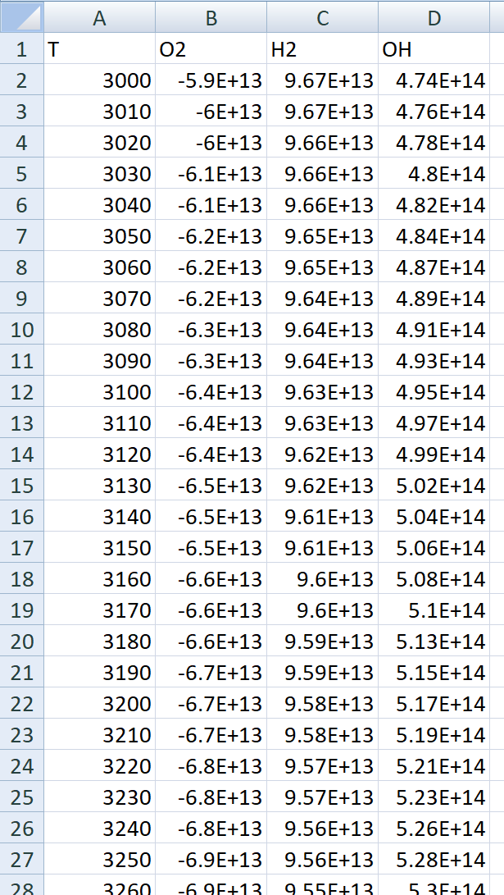
TO_TABLE() METHOD
VARIETY OF SELECTABLE OUTPUTS
ReactionSet.to_table(query_species, concs, temps, out_file, out_type = {'csv‘, ‘txt’, ‘latex’, ‘hdf5’} )
Fig. 1: LATEX output
Fig. 2: .txt/email output
Fig. 3: CSV output

Slide 12
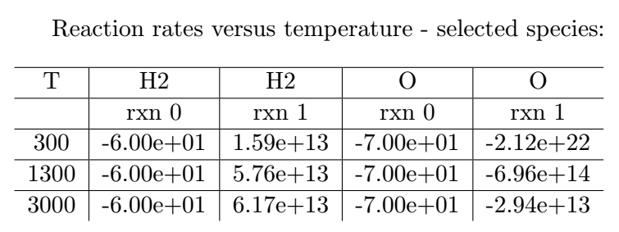
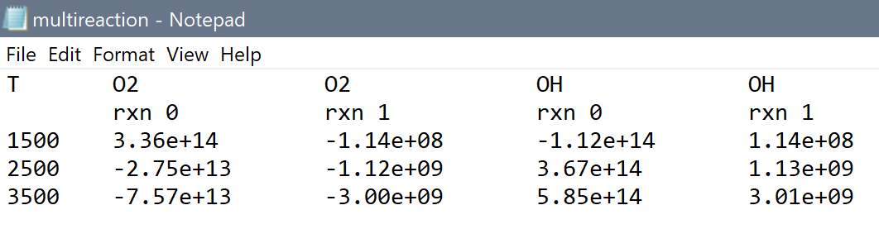
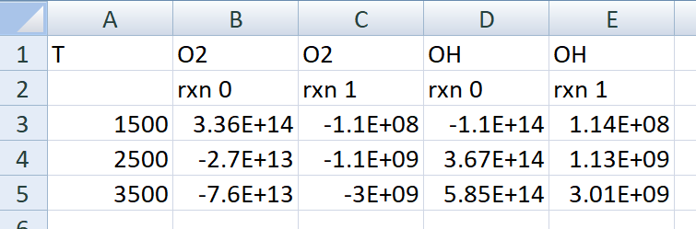
TO_MULTI_TABLE()
METHOD
Fig. 1: LATEX output
MultiReactionSet is instantiated by passing a list of ReactionSets
Then, cross-tabulated outputs can be achieved with:
to_table_multi(
query_species,
concs,
temps,
output_dir,
out_type = 'csv‘ )
Fig. 2: .txt/email output
Fig. 3: CSV output

Slide 13
IN CONCLUSION…
We hope this package will streamline the workflow process for chemical kinetics reaction research.
Thanks to:
The entire CS207 teaching team for their support
David Sondak for teaching us what a chemical kinetics is ☺

Slide 14

IN CONCLUSION…
QUESTIONS?

